Slide 1

SOFTWARE TESTING
UE18CS400SB
Prof. Venkatesh Prasad
venkateshprasad@pes.edu
Department of Computer Science

Slide 2

SOFTWARE TESTING
Blackbox testing
Venkatesh Prasad
Department of Computer Science and Engineering

Slide 3
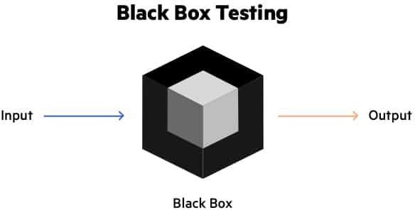
SOFTWARE TESTING
What is Black Box Testing?
Black box testing is done
With only the functional knowledge of the system
Without the knowledge of the internals of the system under test.

Slide 4

SOFTWARE TESTING
Lock-and-Key Example of Black Box Testing
We do not know the internal structure
Levers
We know the inputs
Number of keys, specific sequence of using them and direction of turning each of them
And expected outcome
Locking and unlocking

Slide 5
SOFTWARE TESTING
Characteristics of Black Box Testing
Done based on requirements
Addresses (should address) stated as well as implied requirements
Encompasses the end-user perspective
Checks for valid and invalid conditions / inputs
May or may not know the technology aspects of the product

Slide 6
SOFTWARE TESTING
When we do Black Box testing?
Unlike traditional white box testing, black box testing is beneficial for testing software usability.
The overall functionality of the system under test
Black box testing gives you a broader picture of the software.
This testing approach sees an application from a user’s perspective.
To test the software as a whole system rather than different modules.

Slide 7
SOFTWARE TESTING
Differences Between White Box and Black Box Testing
Black Box Testing | White Box Testing
Has no access to program code | Has access to program code
Requires external perspective | Requires knowledge of program code
Set of techniques applicable to all other phases of testing | Typically applies only to unit testing, where code is involved

Slide 8
SOFTWARE TESTING
Principles of Black Box Testing
It is not possible to exhaustively test a product
Choose tests so that we can
Test “as much of the external functionality as possible”
Uncover “as many defects as possible”
Use “as short a time as possible”
Have methodologies that choose tests that have a higher likelihood of uncovering new defects.

Slide 9
SOFTWARE TESTING
Techniques / Methodologies of Black Box Testing
Requirements-based testing
Positive and negative testing
Boundary value analysis
Decision tables
Equivalence partitioning
State-based testing
Compatibility testing
User documentation testing
Domain testing (leads to ad hoc testing)

Slide 10
SOFTWARE TESTING
Advantages
Well suited and efficient for large code segments.
Code access is not required.
Clearly separates user's perspective from the developer's perspective through visibly defined roles.
Large numbers of moderately skilled testers can test the application with no knowledge of implementation, programming language, or operating systems.

Slide 11
SOFTWARE TESTING
Disadvantages
Limited coverage, since only a selected number of test scenarios is actually performed.
Inefficient testing, due to the fact that the tester only has limited knowledge about an application.
Blind coverage, since the tester cannot target specific code segments or errorprone areas.
The test cases are difficult to design.
•
•

Slide 12
SOFTWARE TESTING
Black Box Testing: Objectives (Recap)
To understand:
What black box testing is
The differences between black box testing and white box testing
Different techniques of black box testing

Slide 13

THANK YOU
Prof. Venkatesh Prasad
venkateshprasad@pes.edu
Department of Computer Science

